Slide 1
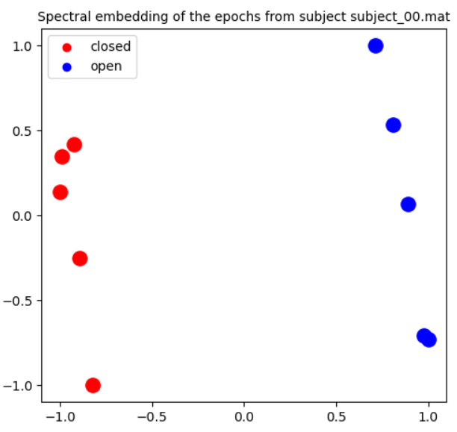
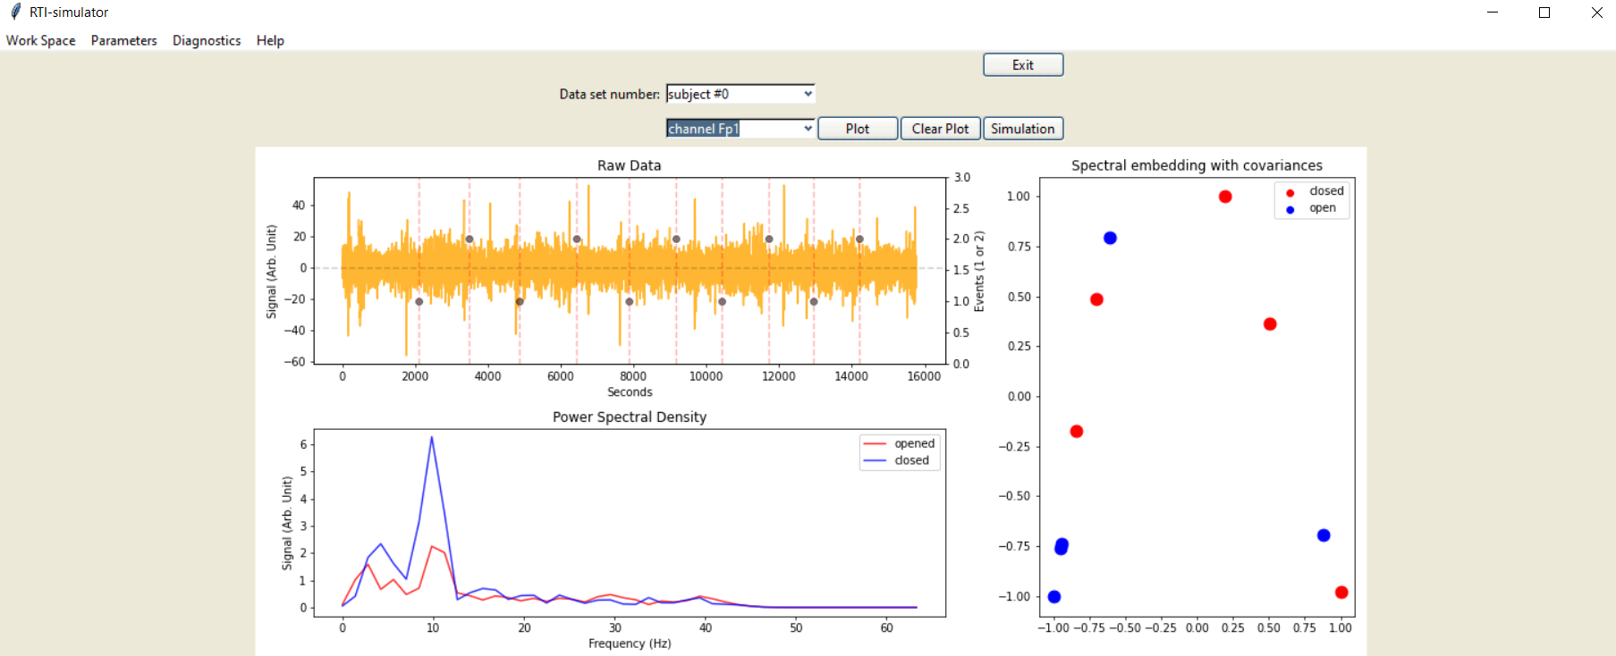

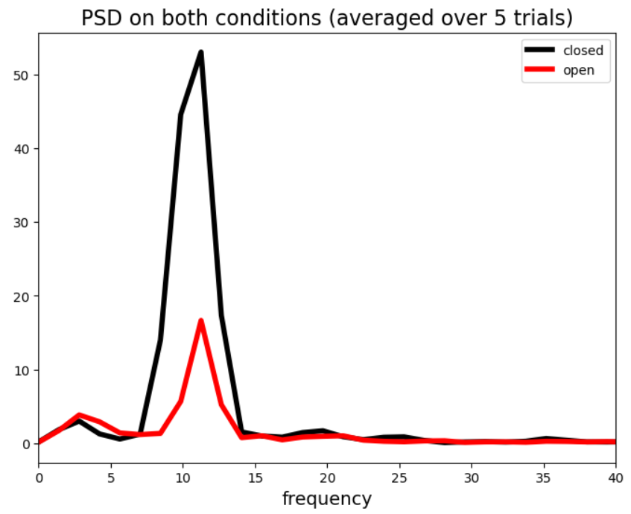
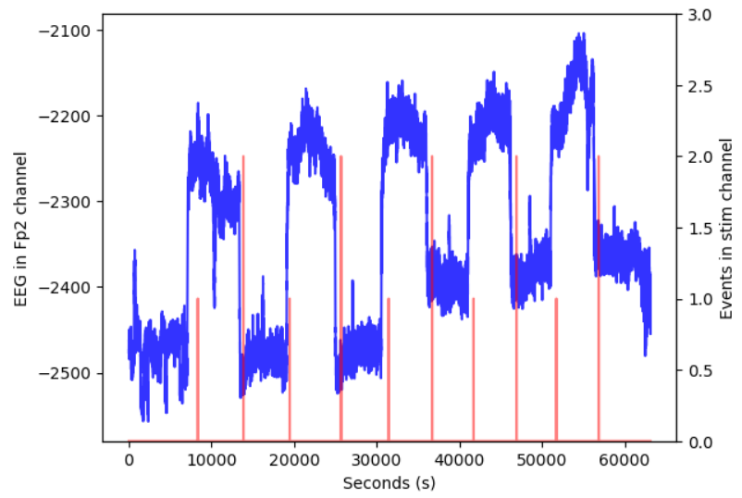
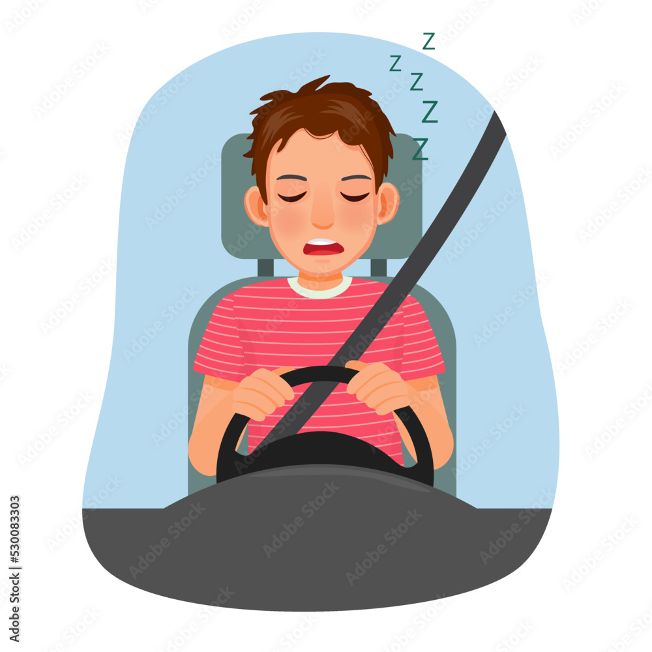
The Detection of Driver’s Fatigue Level
Kiman Park

Slide 2
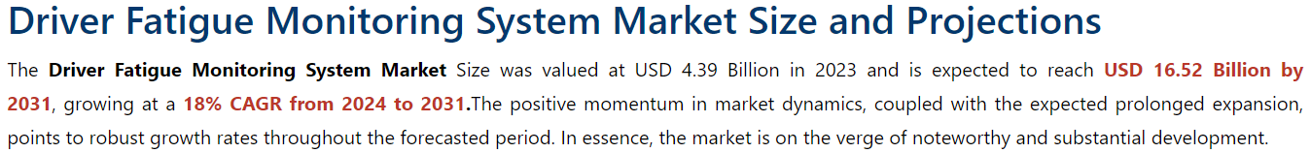
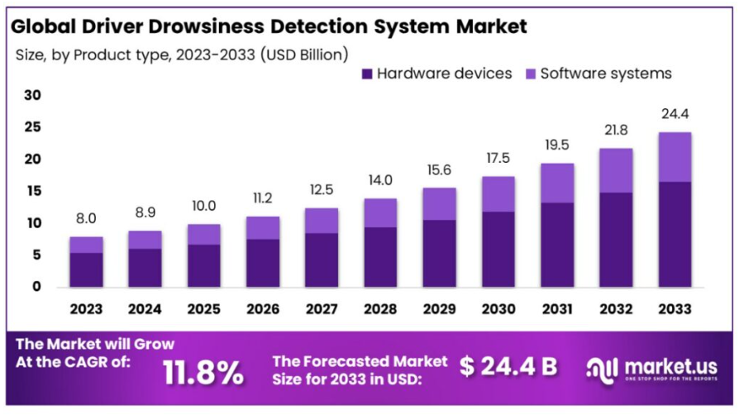
Market Value
https://www.marketresearchintellect.com/product/global-driver-fatigue-monitoring-system-market?utm_source=Artrocker&utm_medium=027/
https://market.us/report/driver-drowsiness-detection-system-market/

Slide 3
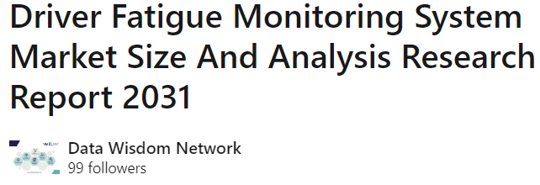

Market Value
https://www.linkedin.com/pulse/driver-fatigue-monitoring-system-market-size-analysis-6dbxc/

Slide 4
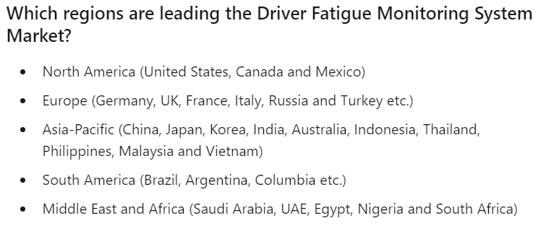
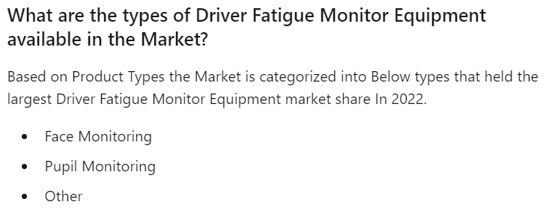
Market Value
https://www.linkedin.com/pulse/driver-fatigue-monitoring-system-market-size-analysis-6dbxc/

Slide 5
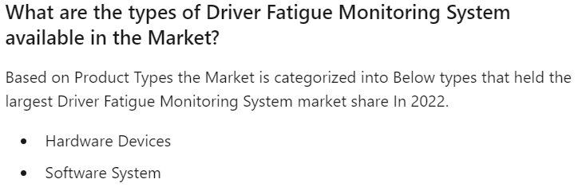
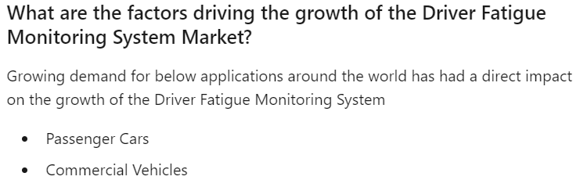
Market Value
https://www.linkedin.com/pulse/driver-fatigue-monitor-equipment-market-size-emerging-13ctc/
https://www.linkedin.com/pulse/driver-fatigue-monitoring-system-market-size-analysis-6dbxc/

Slide 6
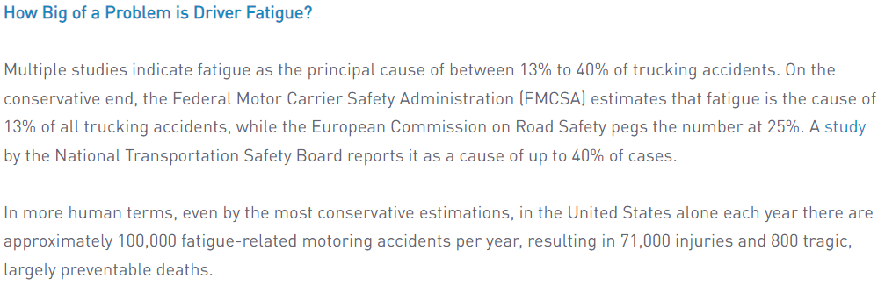
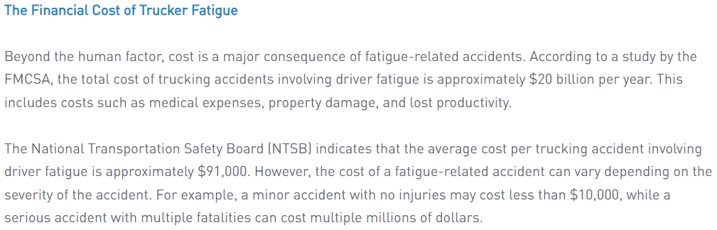
Market Value
https://fatiguescience.com/blog/the-true-cost-of-driver-fatigue-for-your-trucking-fleet/

Slide 7
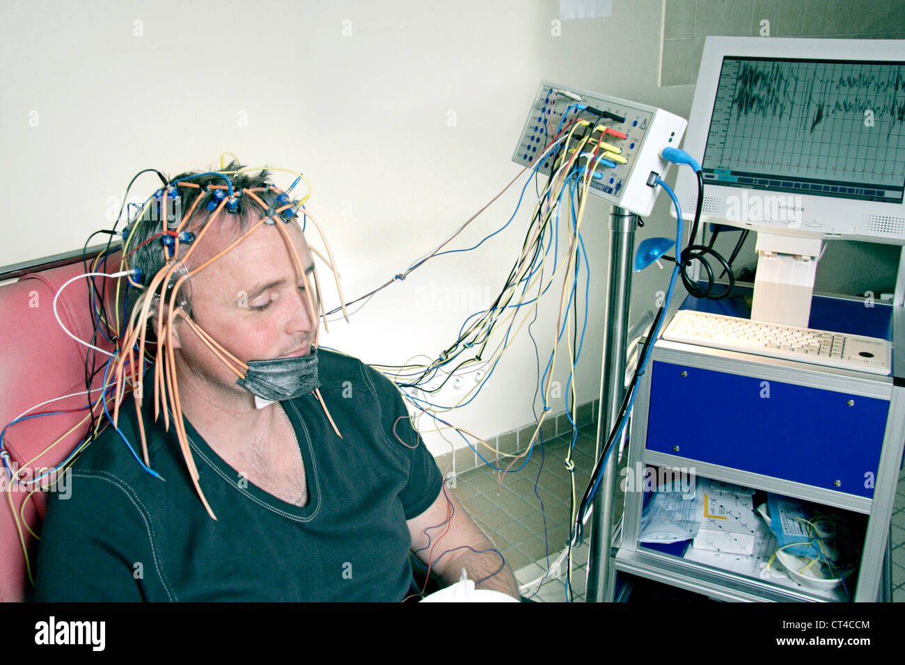
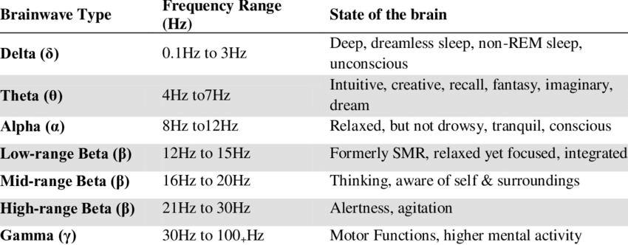
Electroencephalogram (EEG)
Measures brain electrical activity
A lot of literature on measuring sleepiness using EEG measurements
Karolinska sleepiness scale (KSS) level is from 0-10
0 for fully awake
10 for extremely drowsy

Slide 8
Machine learning operation
Acquire data
Data visualization
Data pre-processing
Model fitting
Make real-time inference
Load the model into the software
https://zenodo.org/records/2348892

Slide 9
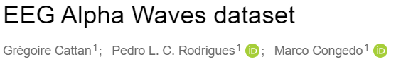
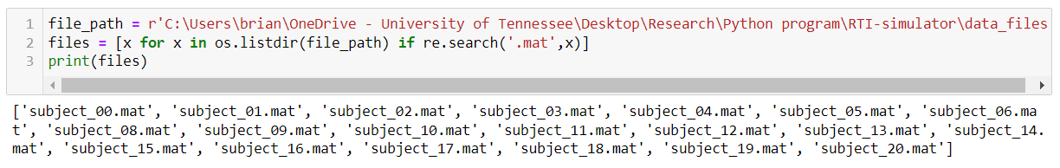
Dataset
21 subjects
https://zenodo.org/records/2348892

Slide 10
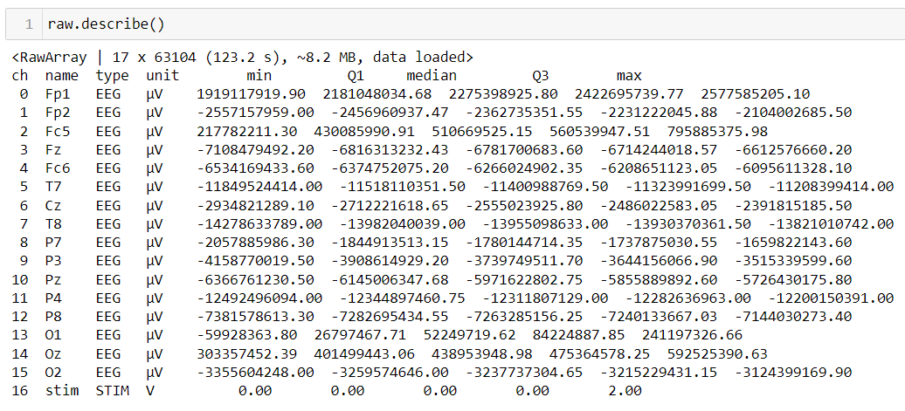
Description of data

Slide 11
Data visualization

Slide 12
Data visualization

Slide 13
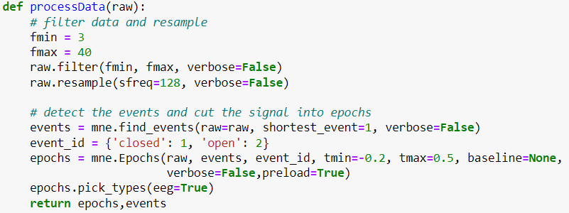
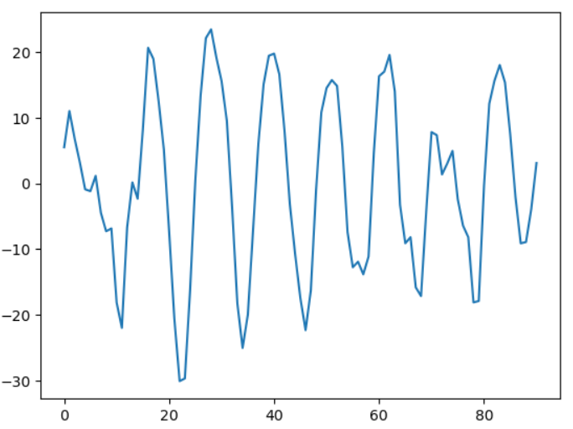
Data pre-processing

Slide 14
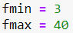
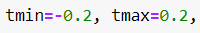
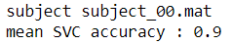
Model fitting
Pre-processing parameters
One subject, one channel
10 measurements
Standard Scaler
Cross-validation
SVC
One subject, one channel
10 measurements
Standard Scaler
Train/test split
SVC

Slide 15
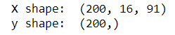
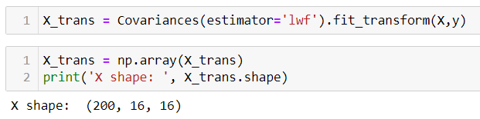
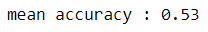
Model fitting
Pre-processing parameters
All subjects, All channels
200 measurements
Covariance
Cross-validation
SVC

Slide 16
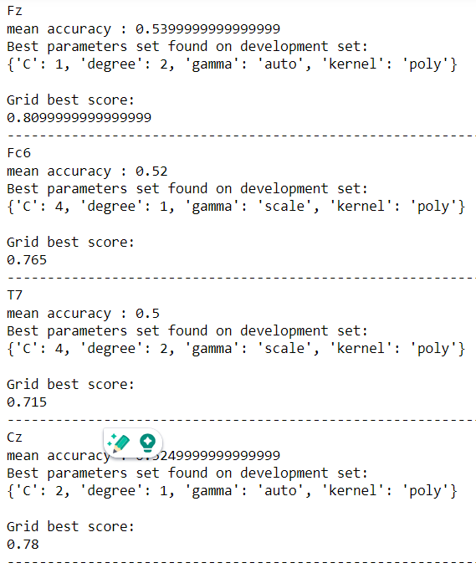
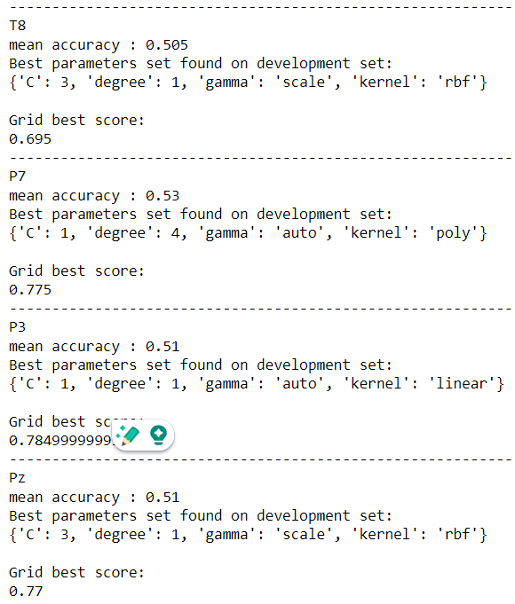
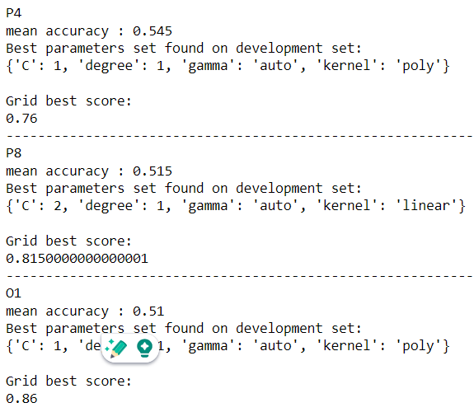
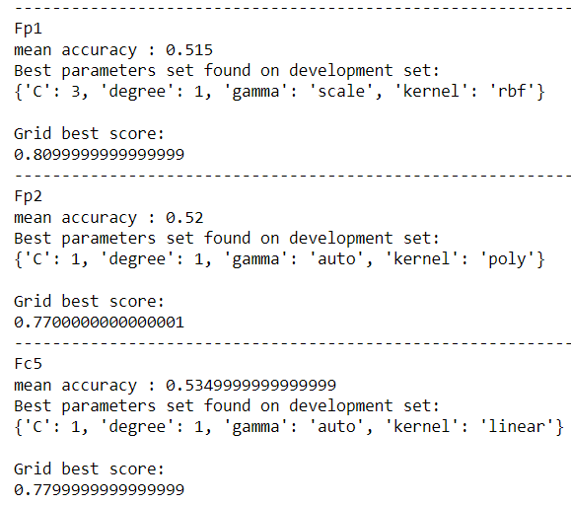
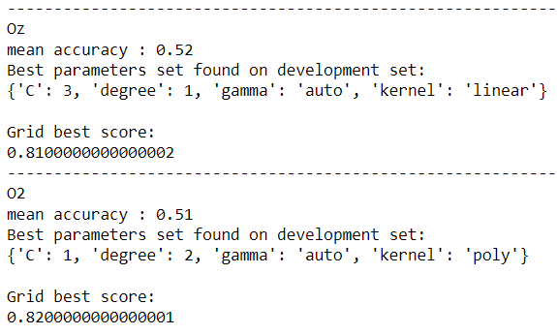
Model fitting
All subjects, One channels
200 measurements
Covariance
Cross-validation
SVC

Slide 17
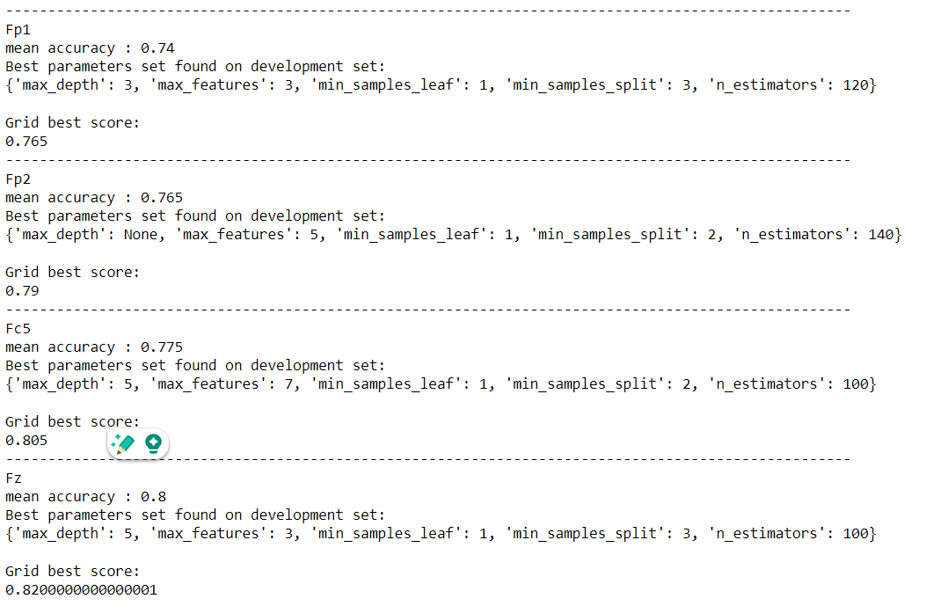
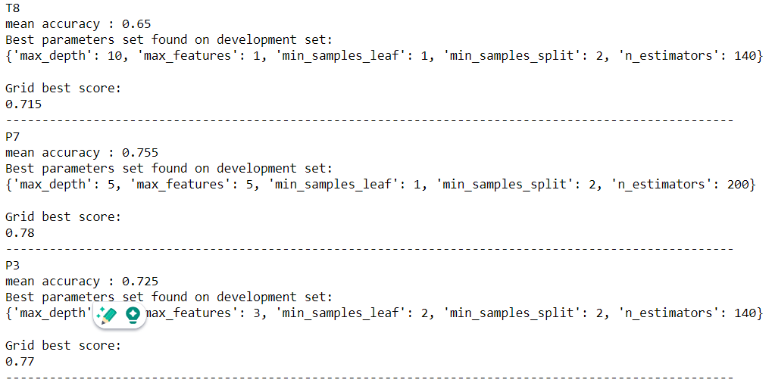
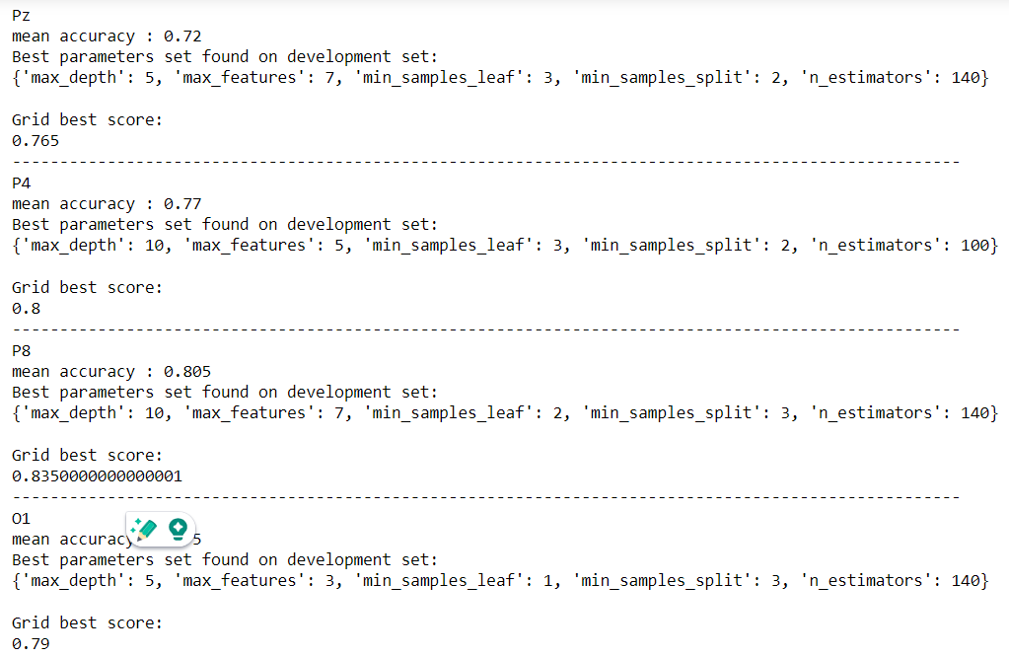
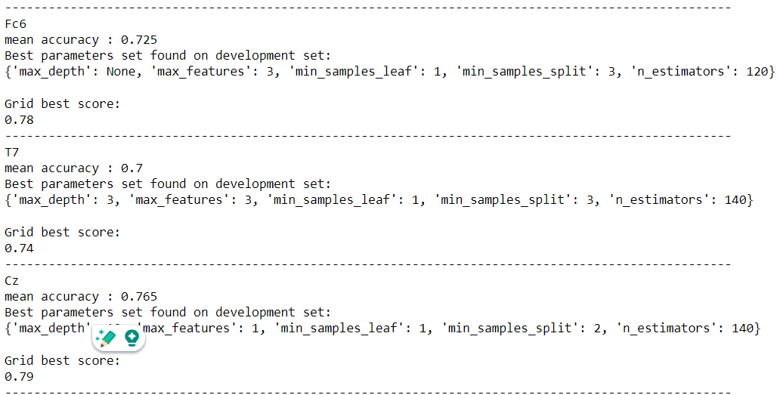
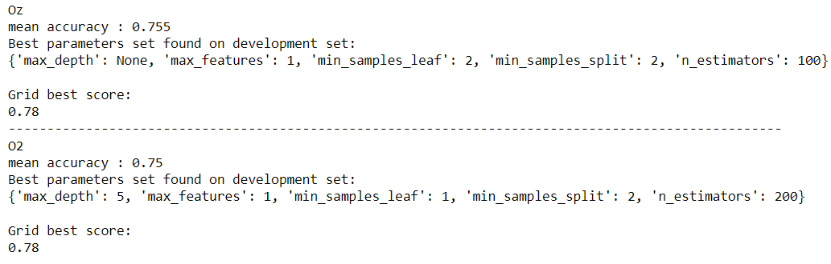
Model fitting
All subjects, One channels
200 measurements
Covariance
Cross-validation
Random Forest

Slide 18
Model fitting
All subjects, One channels
200 measurements
Covariance
Cross-validation
SVC
All subjects, One channels
200 measurements
Covariance
Cross-validation
Random Forest

Slide 19
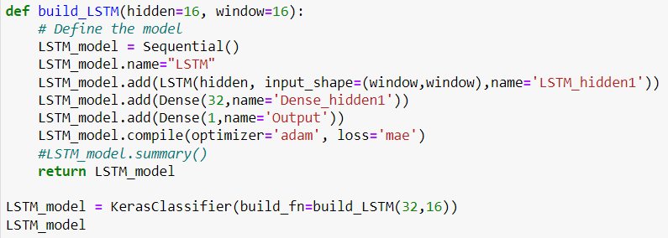
Model fitting
All subjects, All channels
200 measurements
Covariance
Cross-validation
LSTM

Slide 20
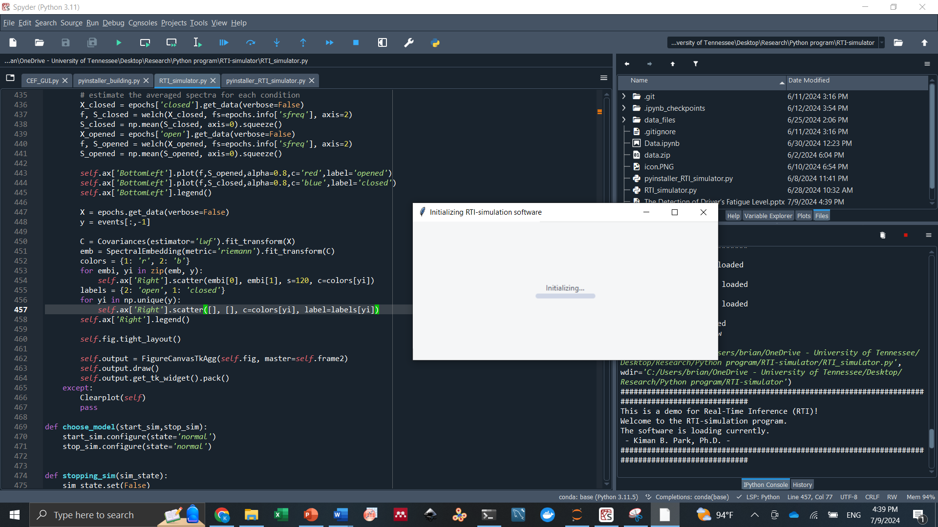
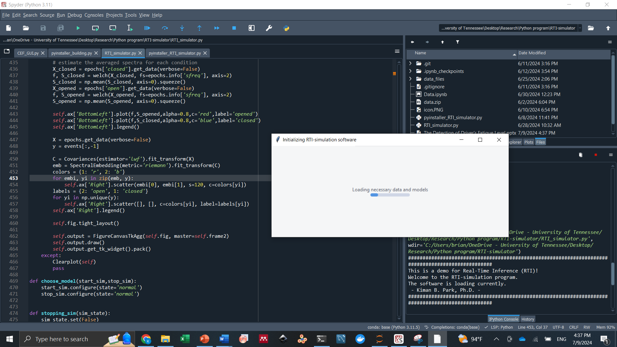
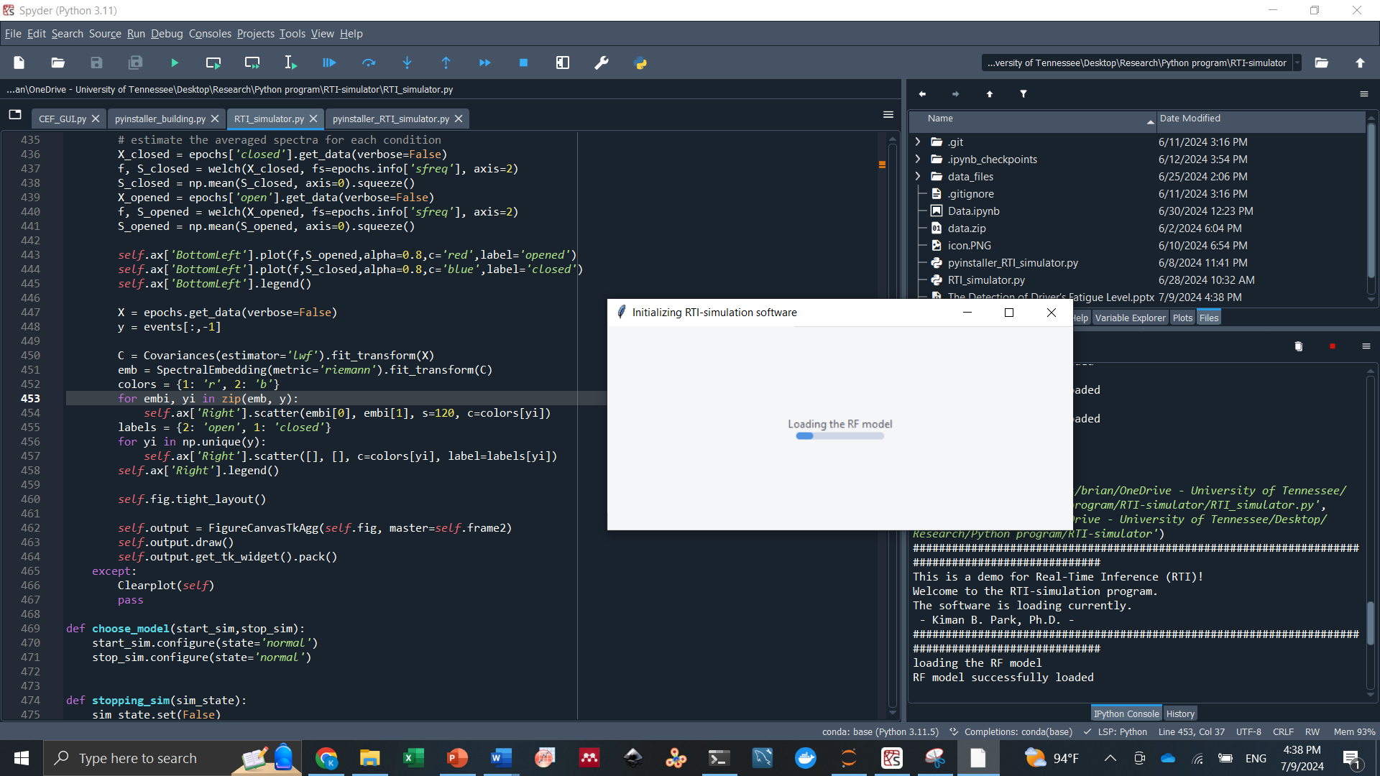
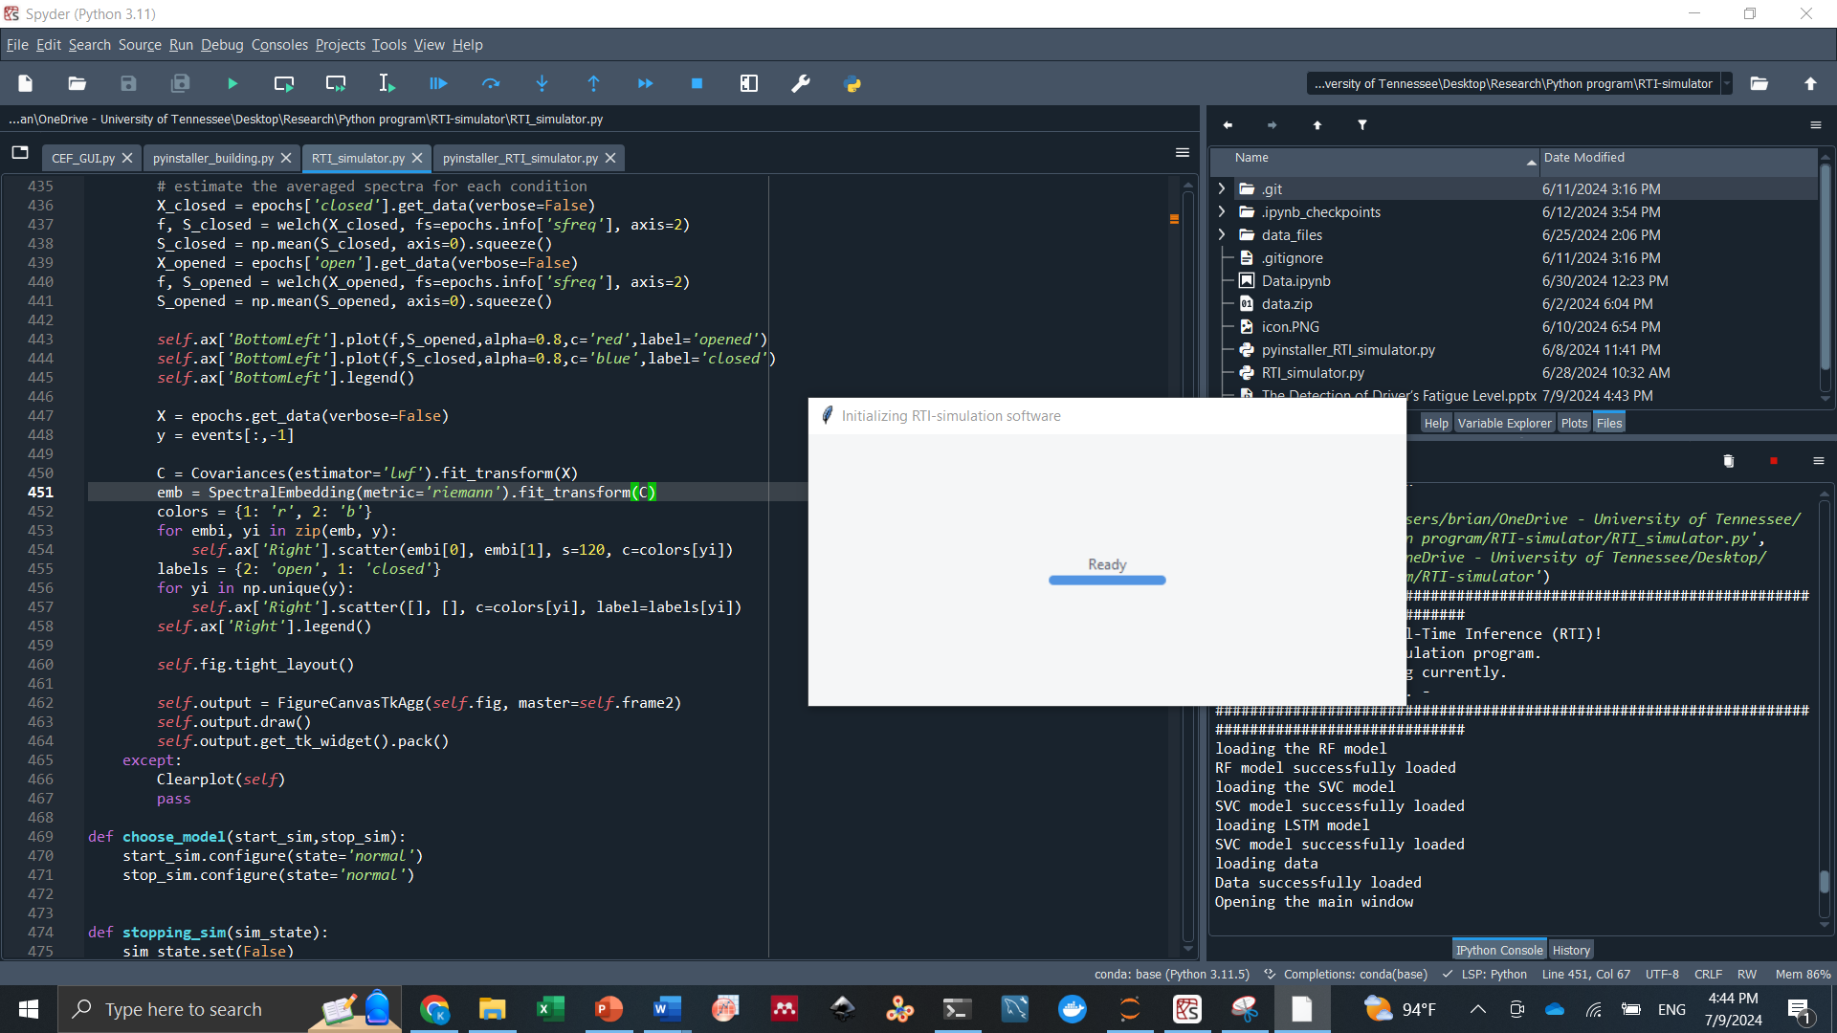
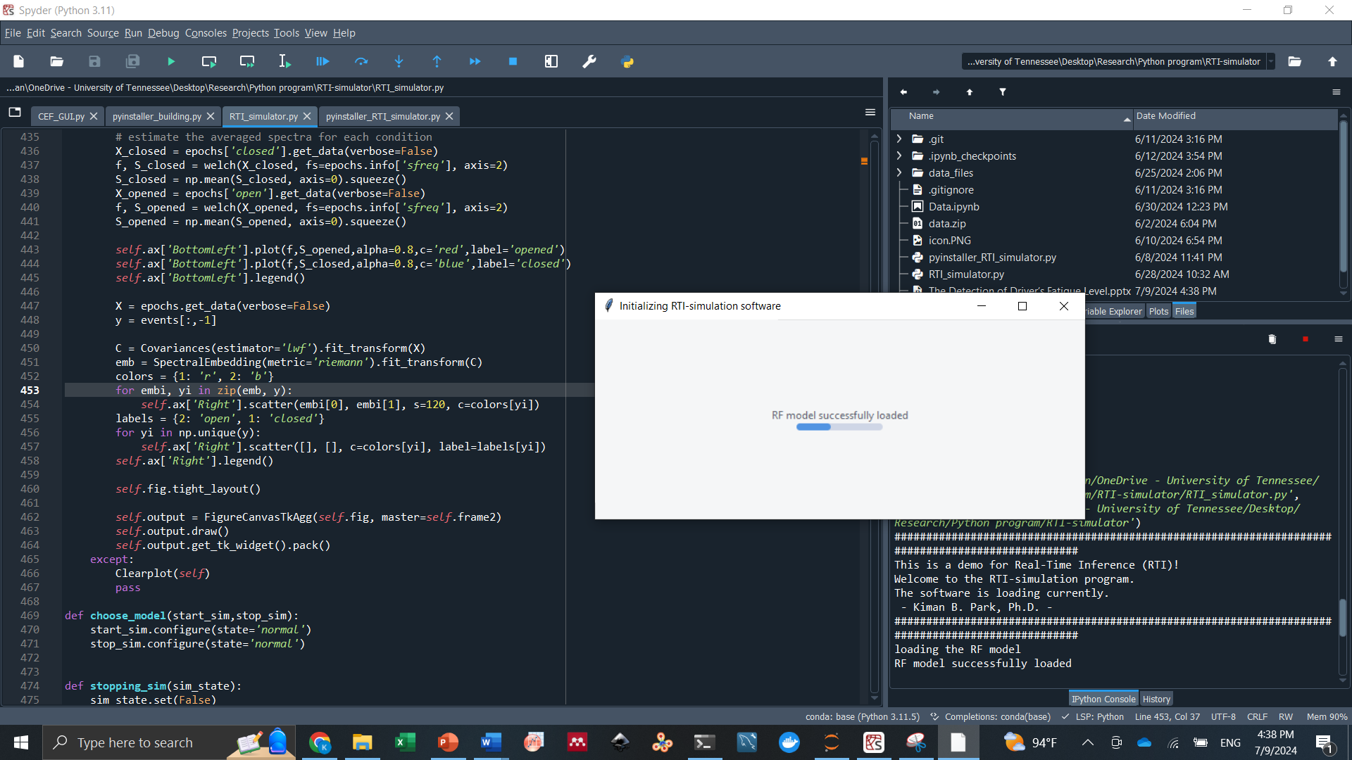

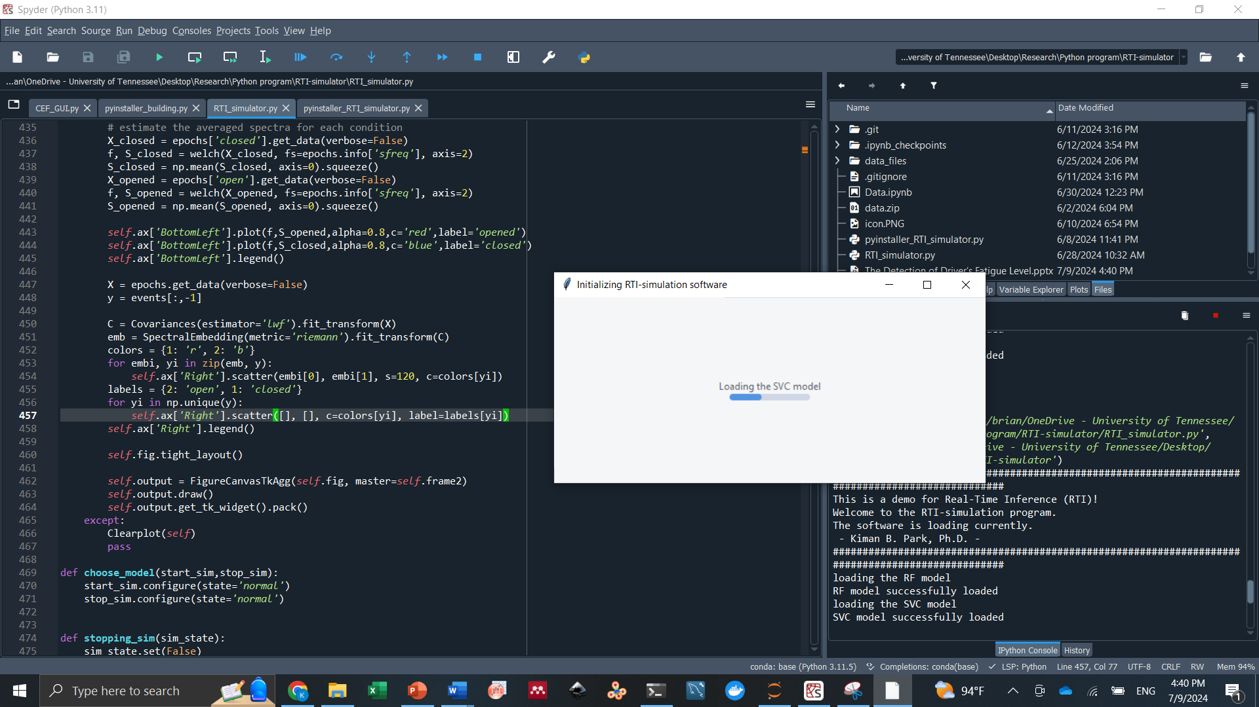
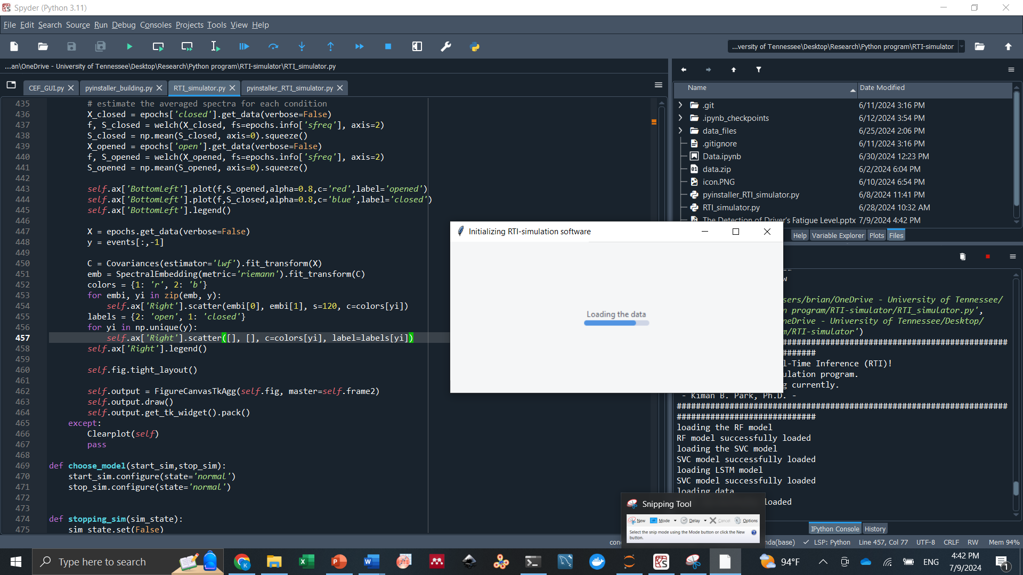
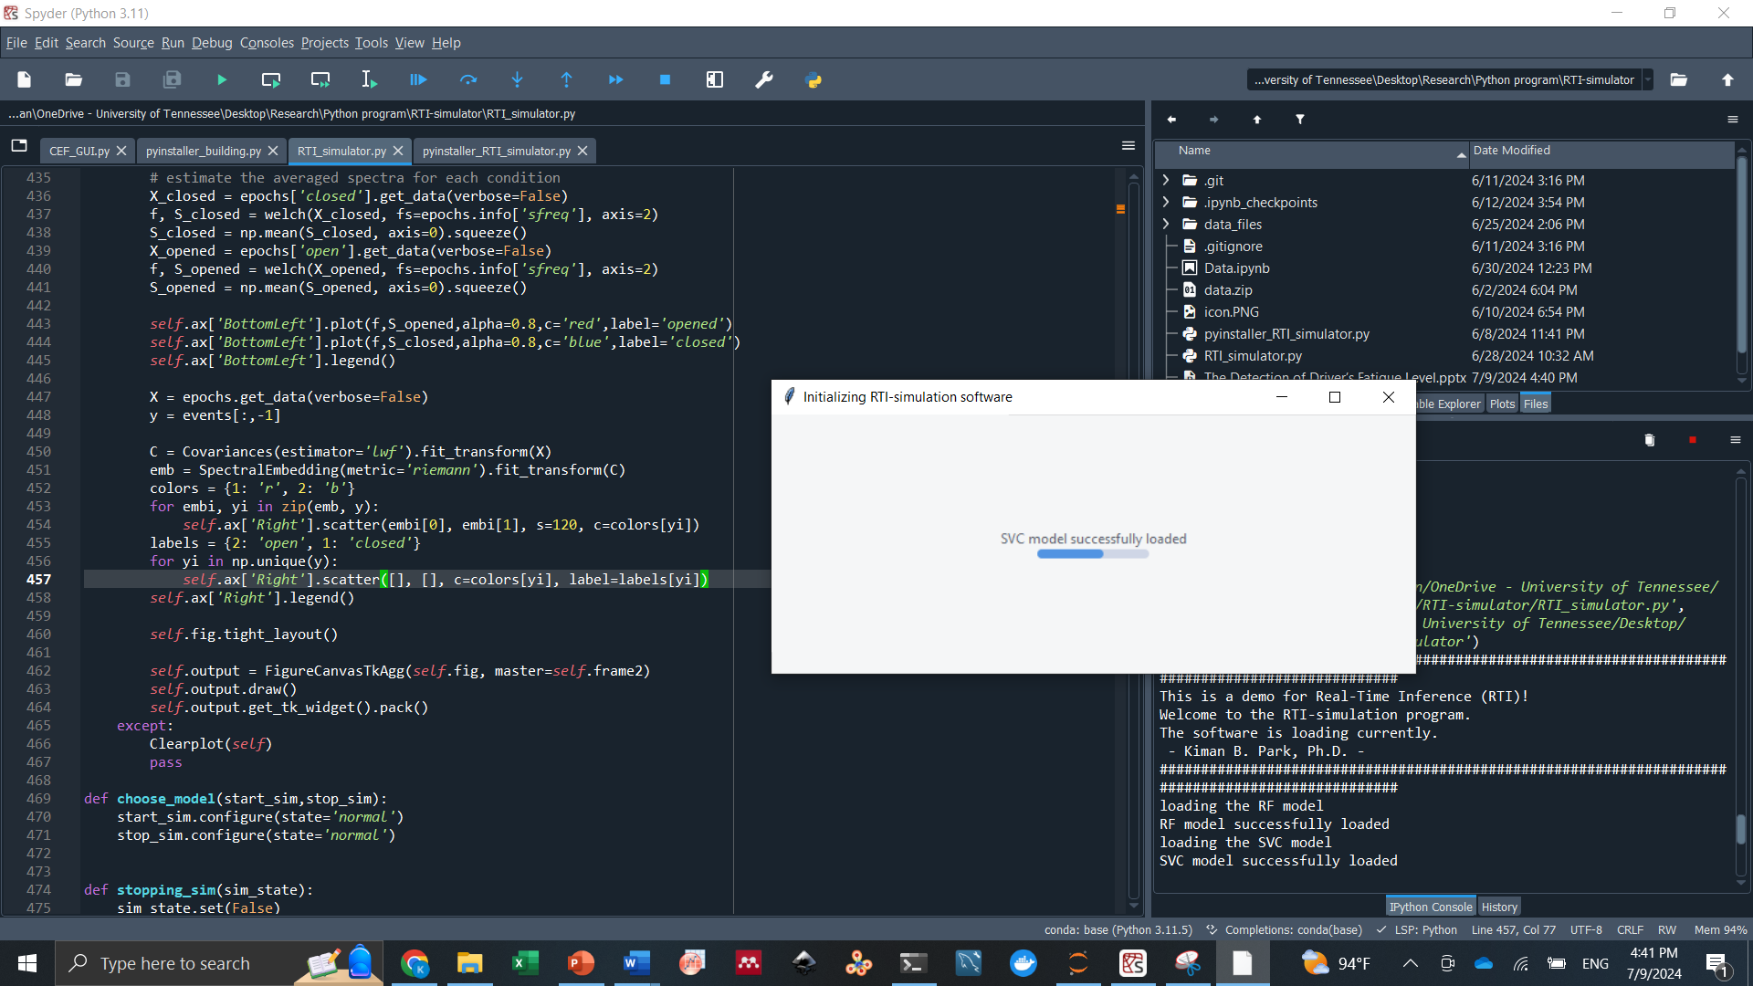

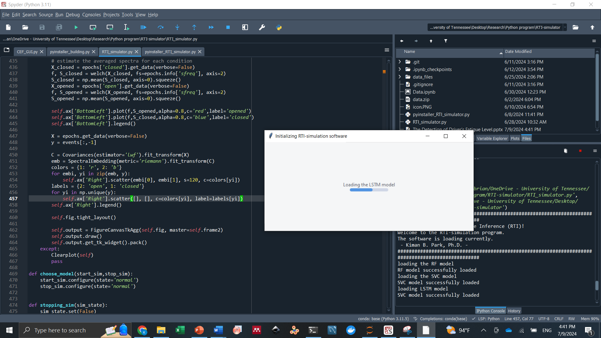
Software Development

Slide 21
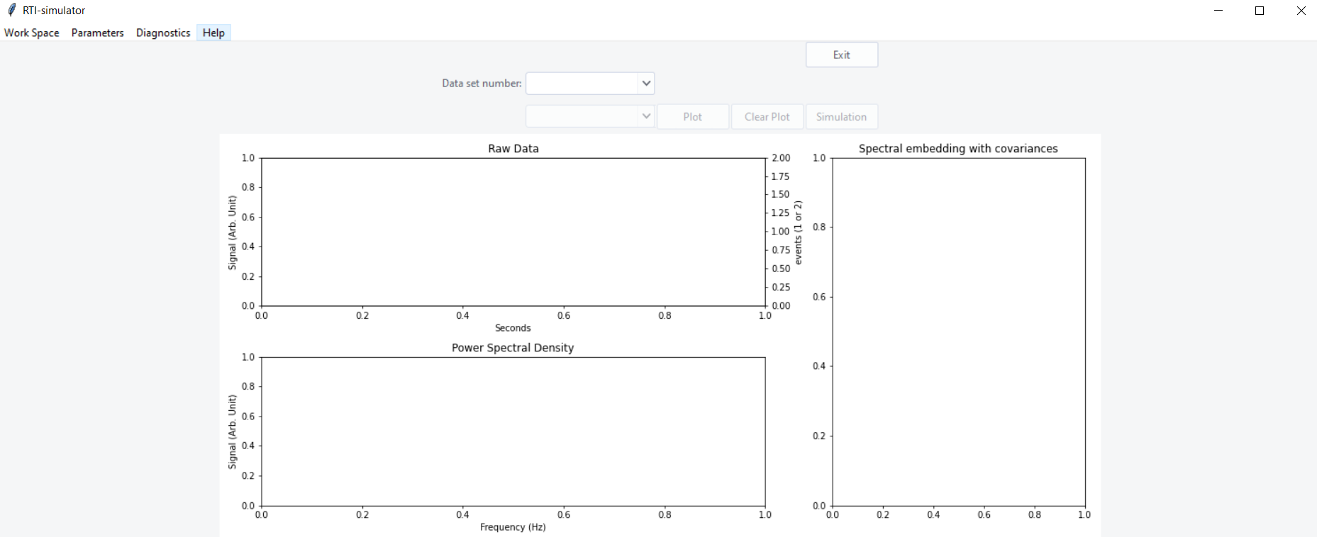
Software Development

Slide 22
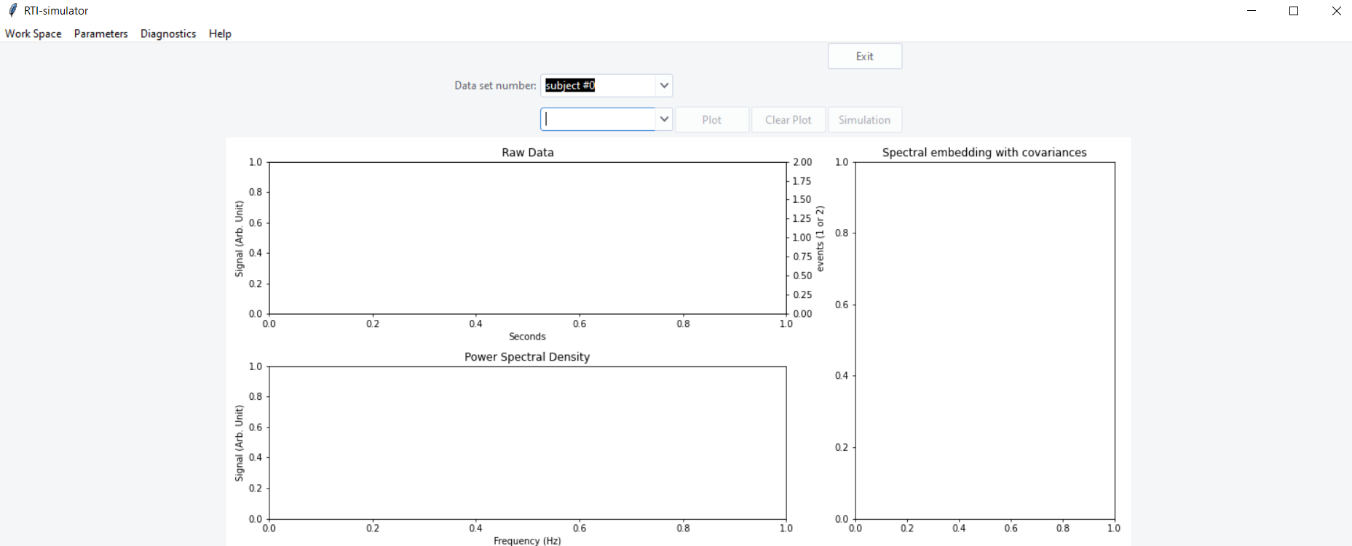
Software Development

Slide 23
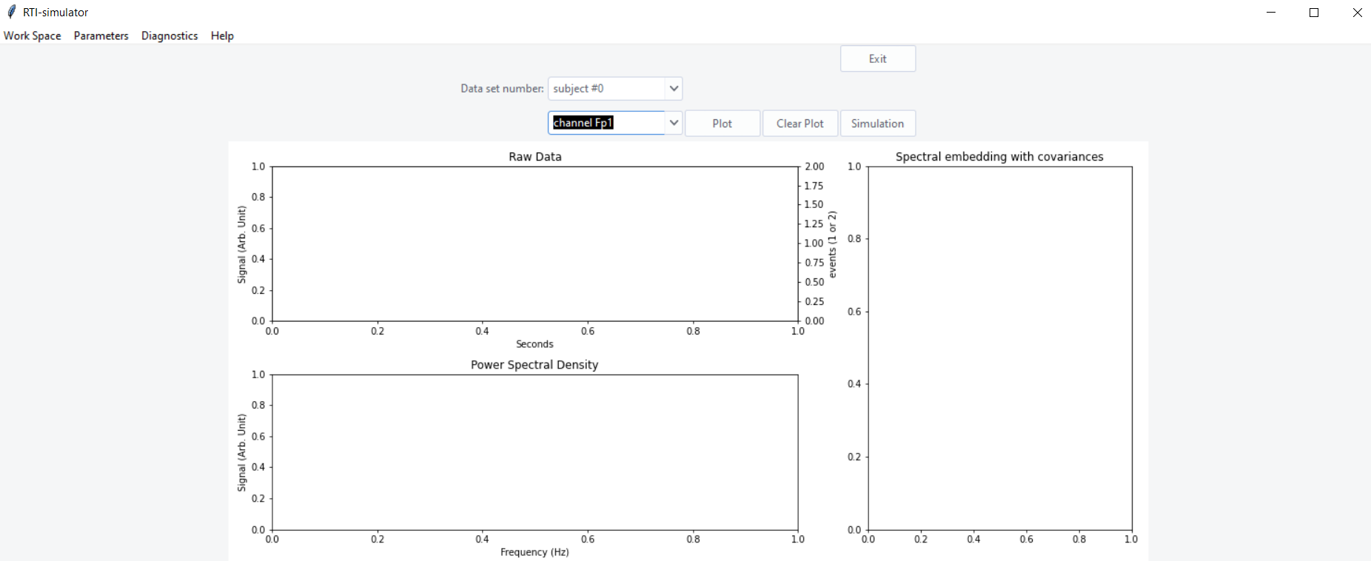
Software Development

Slide 24

Software Development

Slide 25


Software Development

Slide 26
Software Development

Slide 27



Software Development

Slide 28
Software Development

Slide 29



Software Development
Also, the alert has the sound!

Slide 30
Machine learning operation
Acquire data
Data visualization
Data pre-processing
Model fitting
Make real-time inference
Load the model into the software
https://zenodo.org/records/2348892

